Slide 1

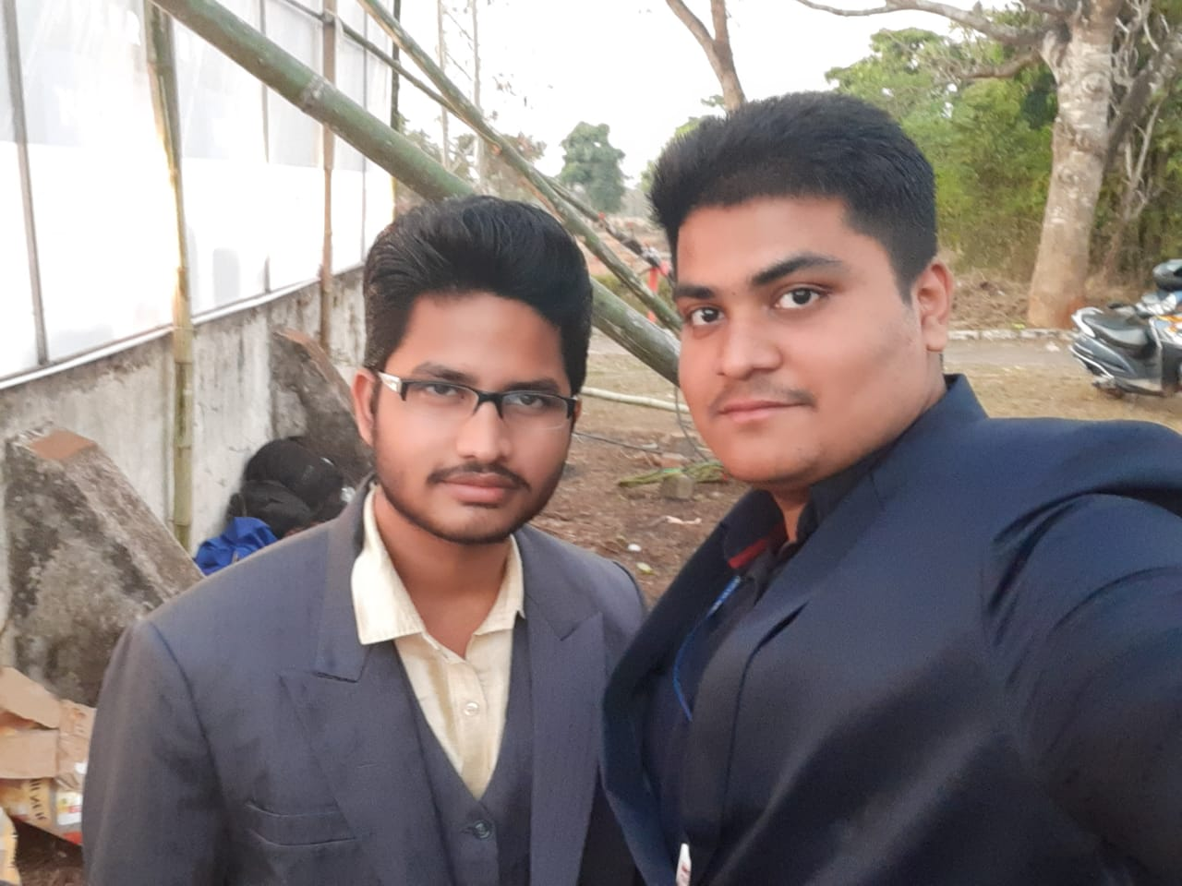
ANUP PAIKARAY
B.TECH 2nd Year IEE , CET BBSR

Slide 2
MUD CHULA KA NAYA LOOK VENTI-COOK

Slide 3
3 BILLION PEOPLE IN WORLD ANF 300 M IN INDIA
INFOGRAPGIC MAP SHOWING DEPENDANCY ACCORDING TO COUNTRY ON BIOMASS
1
High Dependency
2
Indirect Dependency
3
Very Low dependency

Slide 4
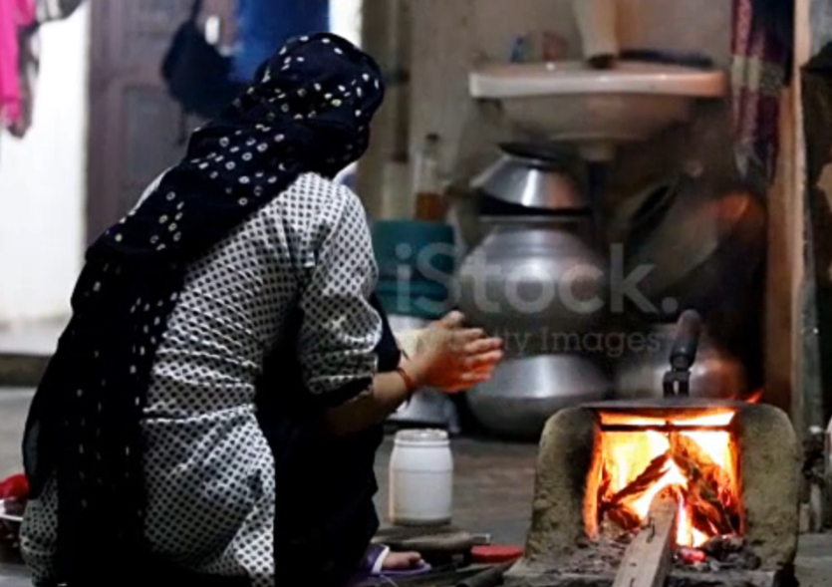
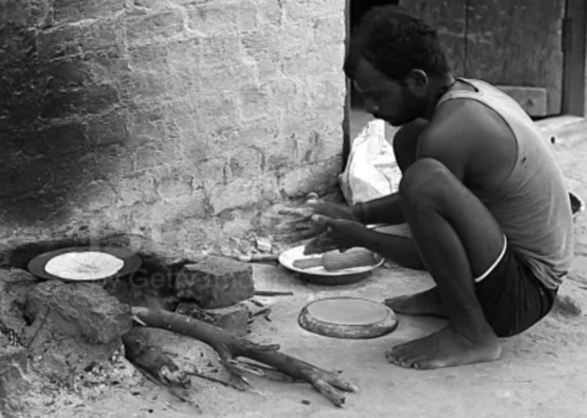
HEALTH HAZARDS OF MUD STOVE
Mud stove create harmful smokes killing 2 million, every year in India.
Continuously sitting in squatting position leads to back problems

Slide 5
2 MILLION DEATHS PER YEAR
NUMBER OF DEATHS FROM INDOOR AIR POLLUTION INTREMS OF GENDER
27%
73%
MALE
FEMALE

Slide 6
PROPOSED SOLUTION
Our project is biomass burning dual-fan cooking stove with one fan being an air inlet that will push fresh air inside the stove for complete combustion and the exhaust fan will emit out any smoke produced.
Both the fan will run by a pedal mechanism, the user now have to seat in chair rather than sitting in that squatting position

Slide 7
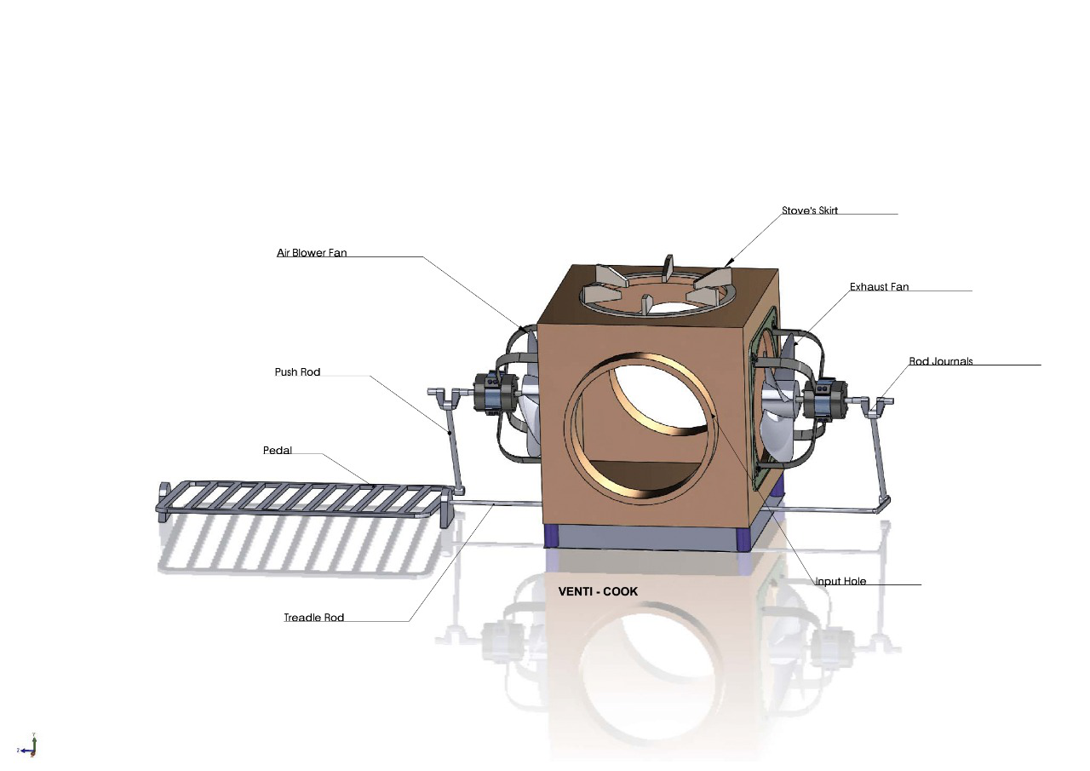
VENTI – COOK
3D Image of VENTI-COOK using SolidWorks

Slide 8
WHICH ONE IS THE BEST
INDUCTION
LPG
VENTI-COOK
Need Rs. 700 for stove , 300 for gas and 200 for lighter and supply pipe.
Monthly refilling Rs 300 per cylinder.
Hard for rural people to use phone for booking.
Need timing cleaning of stove.
Expensive
Induction specific utensils
Requires steady flow of electricity.
Also not used by majority urban population.
one-time investment of Rs. 800.
Burns on Wood , cow dunk cake , etc.
Easy to use and maintain
Easy to learn as it is similar to mud stove
NEW TECHNOLOGY / STYLE FOR RURAL PEOPLE

Slide 9
BUSNIESS
FUNDS
&
POTENTIAL
REQUIRED
MARKET
STRATEGY

Slide 10
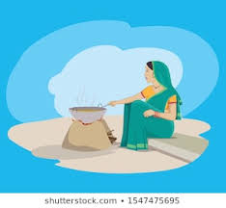



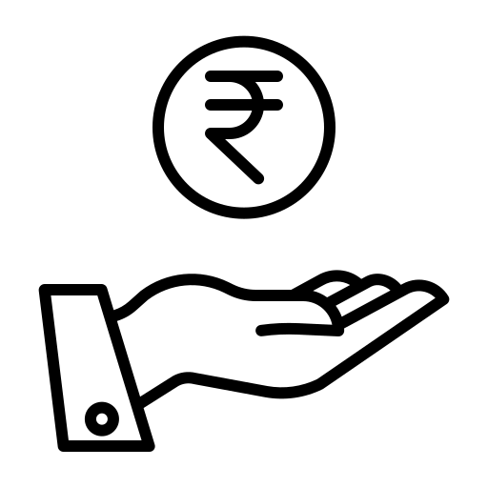
With a MRP of Rs.800
30 crore Indian still depend on mud stove.so we have a huge market size
Manufacturing cost per unit is Rs. 600,
So we have a potential market of estimated Rs. 20 billion (only in India )
With a 25% profit margin , equals to Rs.200.

Slide 11
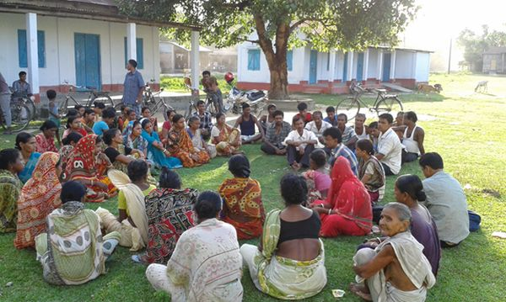
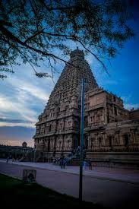
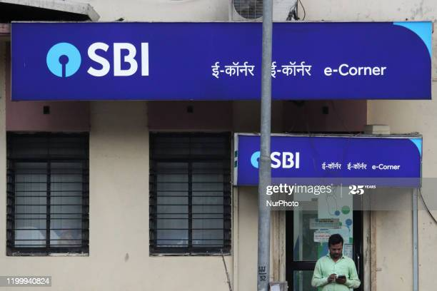
BUSINESS STRATEGY
ADVERTISING OUR PRODUCT BY GIVING FREE VENTI-COOK STOVE TO MANDIR FOR MAKING OF PRASAD.
SPREADING AWARENESS ABOUT HEALTH HAZARD OF MUD STOVE IN PANCHAYAT.
ATTRACTIVE DISCOUNT SCHEME FOR RURAL PEOPLE WITH BANK ACCOUNT IN GRAMIN BANK.

Slide 12











TOTAL 15 LAKHS INVESTMENT REQUIRED.
INVESTMENT PLANNER

Slide 13


IMAGE | DEFINATION | INVESTMENT NEEDED | % from total investment ( i.e. 15 LAKHS )
 | COMPANY REGISTRATION | Rs. 1,05,000 | 7.0%
 | EQUIPMENTS ( digital) | Rs . 1,00,000 | 6.66%
 | RAW MATERIALS | Rs . 1,50,000 | 10.0 %
 | OFFICE SPACE ( RENT) | Rs.2,00,000 / annum | 13.33 %
 | RESREACH AND DEVELPOMENT | Rs. 3,00,000 | 20.0 %
 | ACCOUNTING & AUDITING | Rs. 20,000 | 1.3 %
 | GOVERNMENT REGISTRATION | VARIABLE ACROSS STATE | ---------
 | ADVERTISEMENT | Rs. 2,00,000 | 13.33%
 | CONSULTANCY | Rs . 80,000/annum | 5.33%
 | PAYROLL FOR EMPLOYEE | Rs . 1,50,000/annum | 10.00%

Slide 14
INVESTMENT
Initial capital needed for lunching product in market
PROFIT OF INVESTMENT
01
03
Profit Rs.200 on each Chula
Expecting 20 lakhs in 1st financial year
INITIAL INVESTMENT
02
TIME NEEDED FOR PROFIT
15 lakhs of investment need to make our product market ready .
It will only take 1 years , to return the investment , only selling 9,000 to 10,000Chula.

Slide 15
USE OF THE INVESTMENT
Collecting and Prioritizing repetitive feedback
Need technical and financial consultancy from mentors
Product pilot
Modification
Advertising
Feedback incorporation
Consultancy
Advertising to create awareness about this issue and reach for govt help
Launch a pilot to understand the market reaction
Modifying according to feedback and doing more experiment.

Slide 16
So do you want to earn profit and also save lives ? YES / NO If yes Venti-cook is the way.

